Slide 1
Advanced
Driver
Assistance
System
for vehicle security and safety

Slide 2

Problem
India's increasing number of road vehicles and traffic congestion have placed road safety on the national agenda.
The Ministry of Road Transport and Highways (MoRTH) registered more than 4.6 lakh road accidents in 2023, which are frequently caused by human failure, bad lane discipline, and lack of situational awareness, especially in cities.

Slide 3
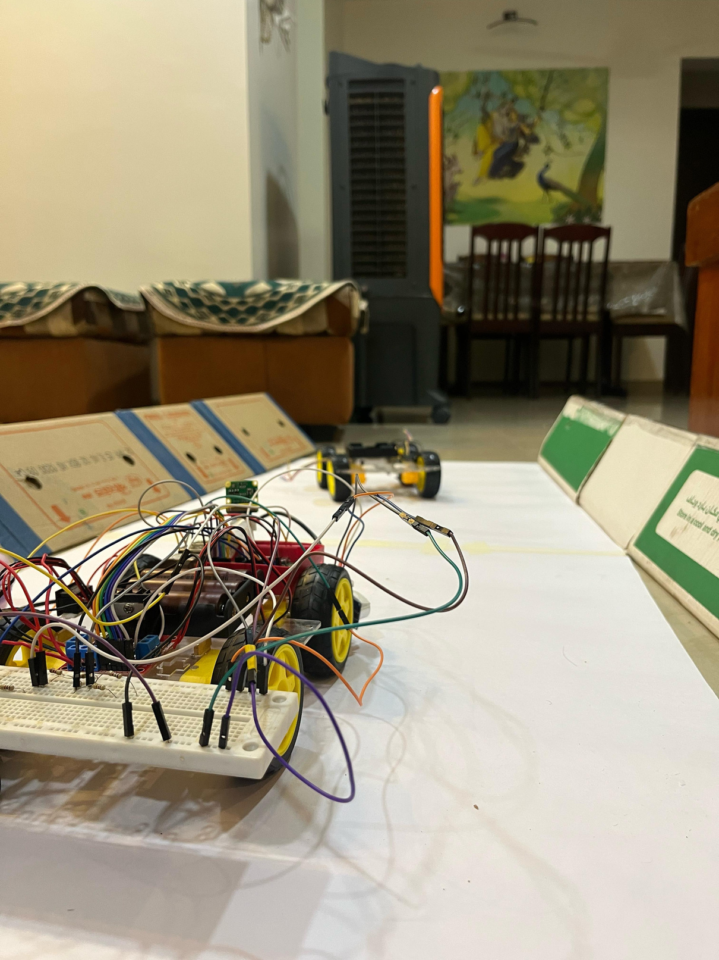
Methodology
We thought of the following ways to implement driver and passenger safety:-
To implement such a model we require a powerful low-cost and power-efficient chip such as a Raspberry Pi 4.
To apply Adaptive Cruise Control we need a way to maintain a fixed distance and speed from the car ahead.
In order to ensure safety of passenger we needed to avoid obstacles on road and alert the driver in case of near collision.

Slide 4
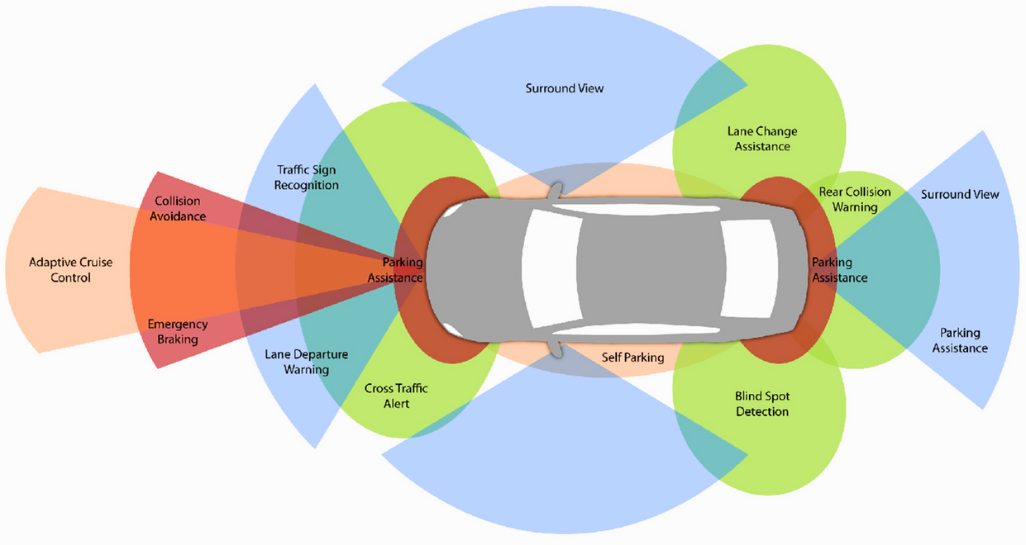
Solution
To improve road safety in India, this project develops a low-cost ADAS prototype using accessible hardware. It features:
Ultrasonic sensors for obstacle detection in front, rear, and blind spots—ideal for congested Indian roads.
L298N sensor to support Adaptive Cruise Control (ACC) by tracking orientation and smooth speed changes.
Raspberry Pi Camera V2 + OpenCV for real-time lane detection, even on poorly marked roads.
Raspberry Pi 4 for sensor fusion, decision-making, and motor control via an L298N driver.

Slide 5
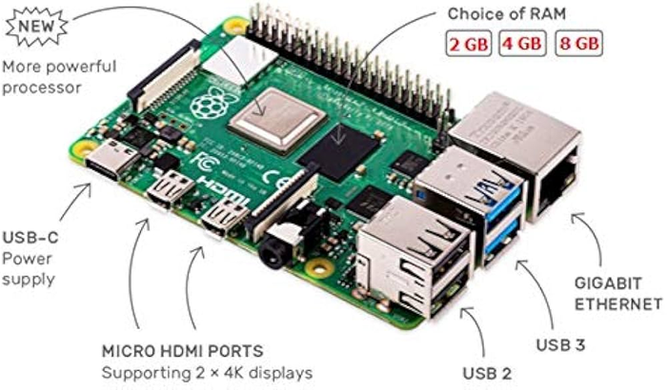
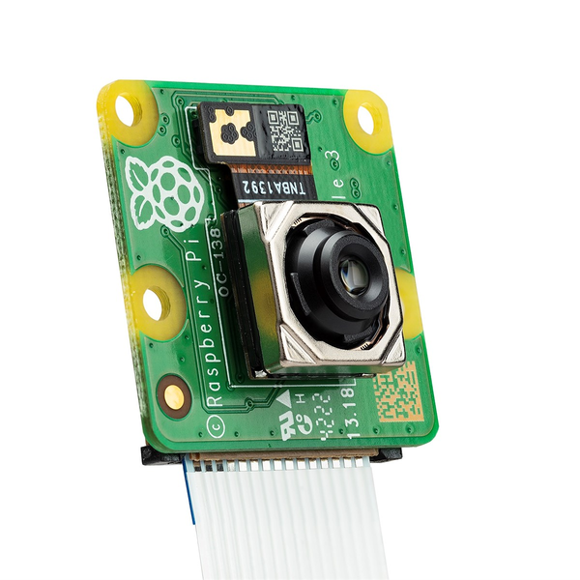
Components
Raspberry Pi 4 Model B
We used this particular model because:-
Low Cost.
Power-Efficient.
Abundant GPIO pins.
Powerful On-board chip and memory for Raspberry Pi Camera and Image Processing.
Raspberry Pi Camera Module 2
We used this particular model because:-
Compact & Light weight.
5 MP Camera.
Seamless Integration with Raspberry Pi.
Real-time Video Processing.
Best performance in budget.

Slide 6
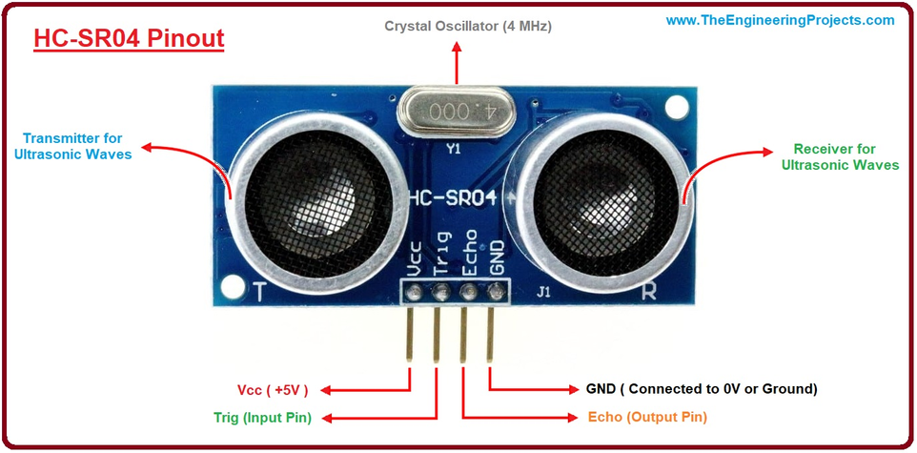
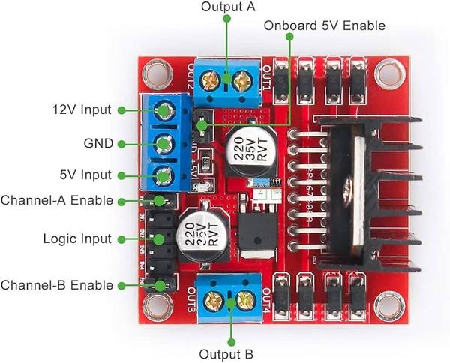
Components
HC-SR04 Ultrasonic Sensor
We used this particular model because:-
Accurate Distance Measurement.
Simple Interface
Works in parallel with multiple sensors.
No dependency on Light
Low Latency Detection
L298N Motor Driver
We used this particular model because:-
Can control up to 4 motors individually.
Bi-Directional Control.
Wide speed control range using Pulse Width Modulation.
Low Cost and widely available.
Stable Performance.

Slide 7
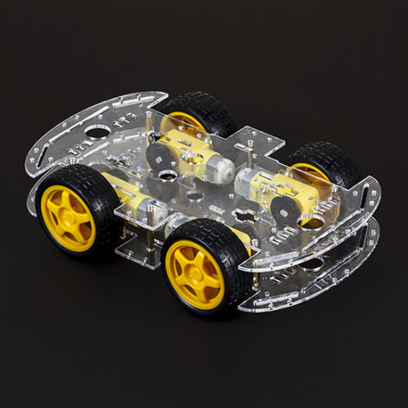
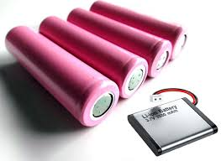
Components
Robot Chassis with DC motors
We used this particular model because:-
Mimics actual car movement and decision making.
Modular Design.
Battery Operable.
Lightweight Model.
Great for Differential Steering.
Li-ion 3.7V Batteries
We used this particular model because:-
Adequate power delivery for L298N and 4 x DC motors.
High Energy Density.
Rechargeable and High Capacity.
Light-weight for Similar power Batteries.
Stable Performance.

Slide 8
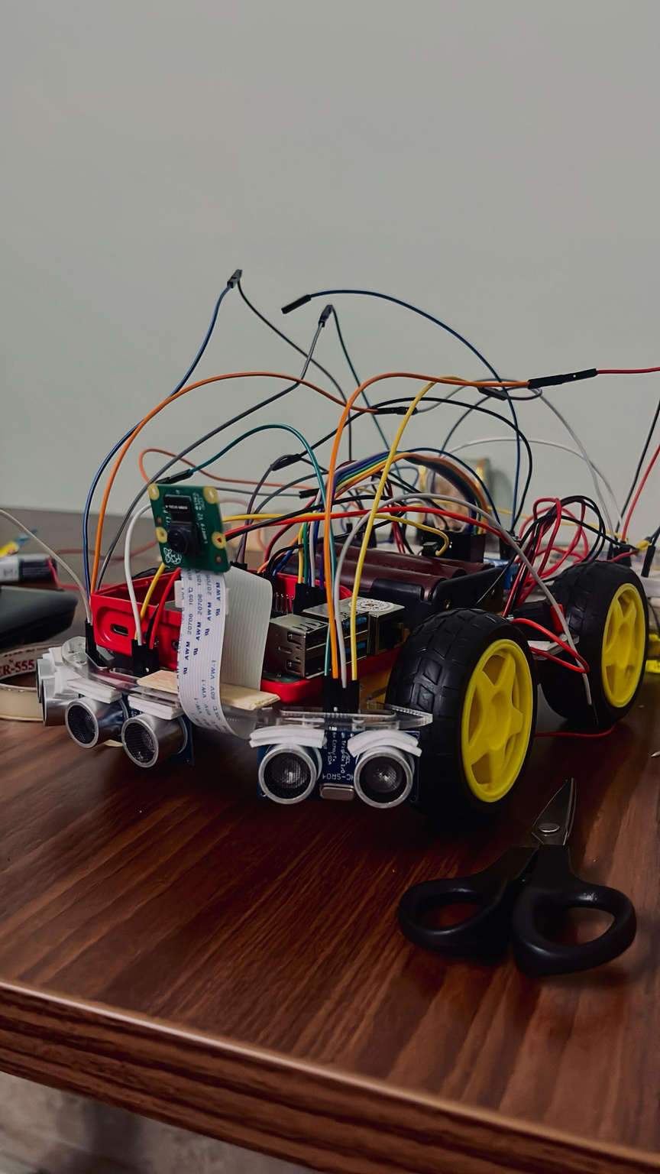
Implementation
We have used Python with OpenCV library for accurate identification of lanes and traffic light change.
We also implemented lane change with use of ultrasonic sensors to check for vehicle in different lanes.
Along with that, we used the ultrasonic sensors for object detection along with the Raspberry Camera module.
We also implemented Adaptive Cruise Control with the help of L298N motor driver to maintain fixed speeds with a comfortable distance between the vehicle and it’s surroundings.

Slide 9
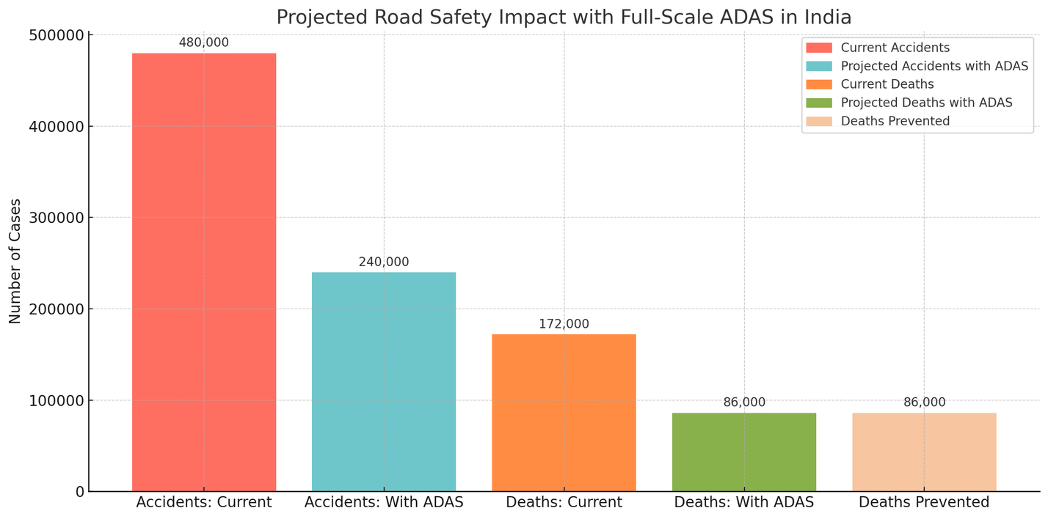
Results
Crash Prevention: ADAS technologies can avoid as many as 62% of traffic crashes.
Lives Saved: Research shows that ADAS can save as many as 20,841 lives annually by avoiding crashes with features such as lane keeping assist and automatic braking for pedestrians.
Specific Feature Benefits:
Forward Collision Prevention: May prevent around 1.7 million crashes annually.
Lane Keeping Assist would prevent 1.12 million accidents every year.
*Many of the lives saved and crash reduction estimates are based on real-world crash data analyses done by Insurance Institute for Highway Safety (IIHS), National Highway, Traffic Safety Administration (NHTSA - USA), European New Car Assessment Programme (Euro NCAP), National Safety Council (NSC)

Slide 10
Conclusion
The development and implementation of an Advanced Driver Assistance System (ADAS) tailored to Indian road conditions represents not just an academic achievement, but a step toward safer, smarter, and more responsible mobility in a country grappling with one of the world's highest road fatality rates.
This system uses adaptive cruise control, collision detection, blind spot monitoring, and lane detection to mimic and even surpass human judgment. Its hardware is made for accessibility, scalability, and application to India's chaotic driving and infrastructure.
This project is visionary in its strategy: to make ADAS innovative and localized as a necessity for daily commuters and Indian families, and not a luxury. National-level implementation can save over 1 lakh lives annually, save families from trauma, and improve road conditions.

